Slide 1


Explore the robustness of non-inferiority procedures in the recurrent events of clinical trials
Yubing Yao
Dec 27th 2013

Slide 2
Outline
Introduction and objective
Simulation scenarios
Results
Summary
Reference

Slide 3
Introduction-non-inferiority test- part 1
Non-inferiority test procedures are based on active controlled studies comparing test drug with existing standard treatment.
The object of non-inferiority test is to show is that any difference between the two treatments is small enough to allow a conclusion that the new drug has at least some effect or, in many cases, an effect that is not too much smaller than the active control, thus clinically and statistically not inferior in effectiveness comparing to the active control.

Slide 4
Introduction-non-inferiority test- part 2
Assume the treatment effect of active control drugs in non-inferiority studies are invariant with those in respective historical placebo-controlled trials, i.e., the constancy assumption. Usually need to run assay sensitivity to validate this assumption.
A variety of methods exist for design and analysis of non-inferiority trials based on recurrent event data including ‘two confidence-intervals’, ‘point estimate’, ‘fixed-margin’.
Notes:
The degrees of conservativeness are different in three methods, ‘two confidence-intervals’ most conservative requiring largest sample size to achieve same power and using the confidence limit for the estimate of the active control to placebo effect(lower limit in our case) , ‘Point Estimate’ using the point estimate for the estimate of the active control to placebo effect, ‘fixed-margin’ treats the estimate of the active control effects in historical trials as a fixed quantity, least conservative and most sensitive to the constancy assumption violations.

Slide 5
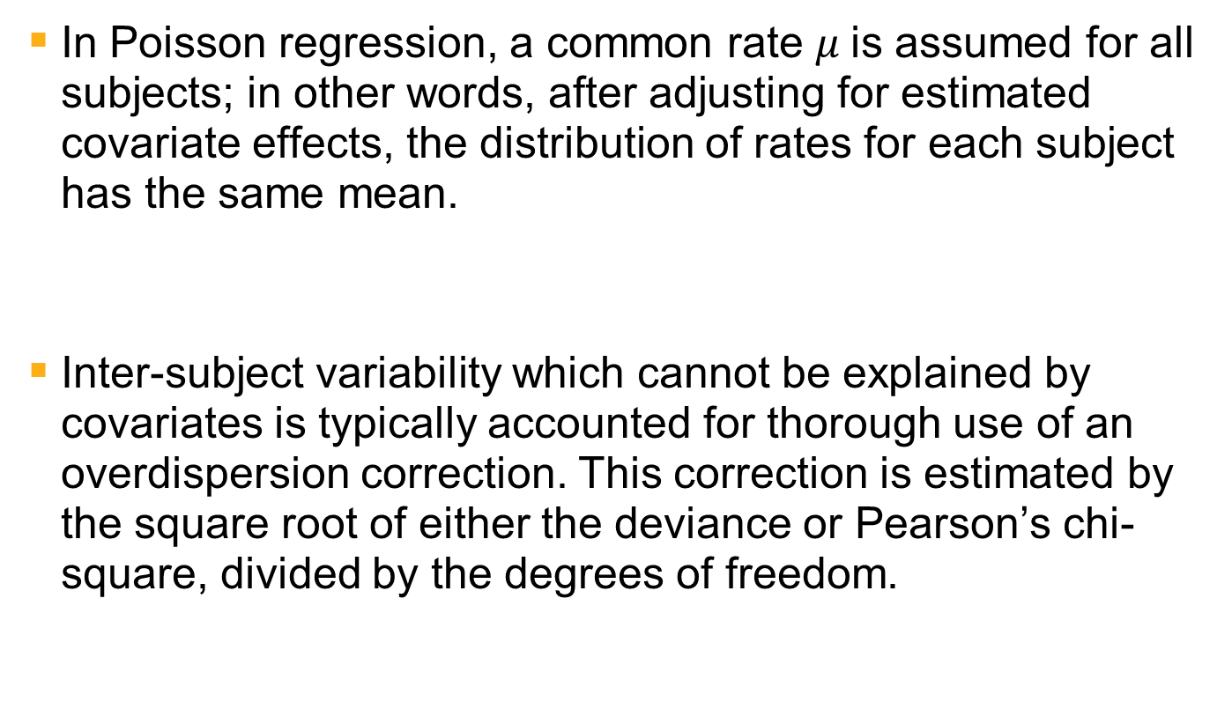
Poisson Regression- An Introduction
In Poisson regression, a common rate $μ$is assumed for all subjects; in other words, after adjusting for estimated covariate effects, the distribution of rates for each subject has the same mean.
Inter-subject variability which cannot be explained by covariates is typically accounted for thorough use of an overdispersion correction. This correction is estimated by the square root of either the deviance or Pearson’s chi-square, divided by the degrees of freedom.
Notes:
Introduce two mainly used methods-Poisson regression(with over-dispersion correction) and negative binomial model in count data.

Slide 6

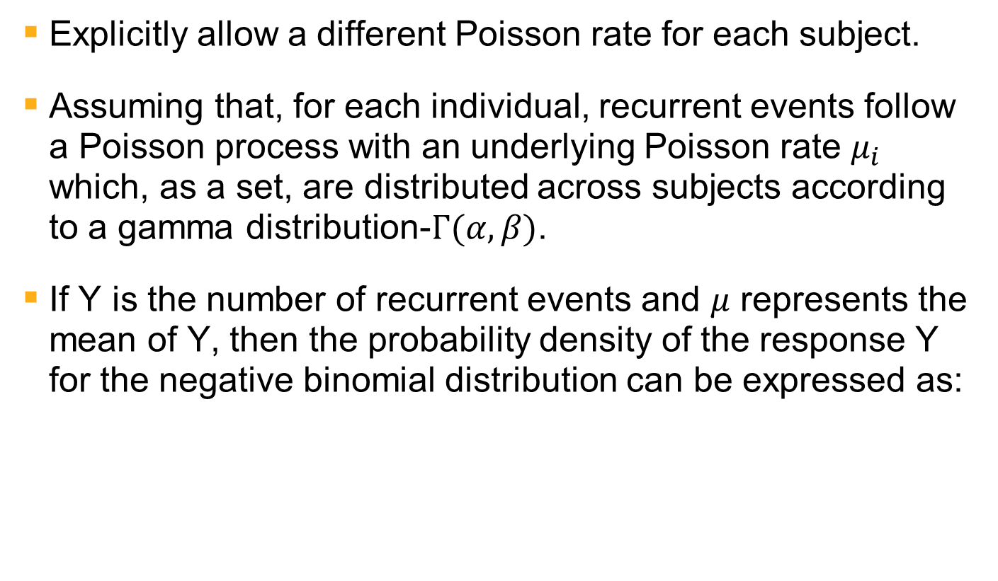
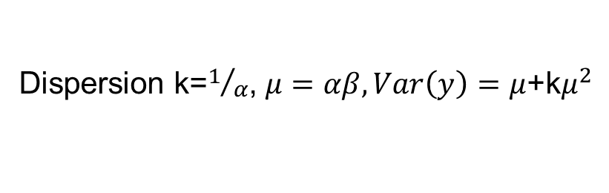
Extension of Poisson Regression-Negative Binomial Model
Explicitly allow a different Poisson rate for each subject.
Assuming that, for each individual, recurrent events follow a Poisson process with an underlying Poisson rate $μ_{i}$ which, as a set, are distributed across subjects according to a gamma distribution-$Γ(α,β)$.
If Y is the number of recurrent events and $μ$ represents the mean of Y, then the probability density of the response Y for the negative binomial distribution can be expressed as:
Dispersion k=$1/α$, $μ=αβ, Var\left(y\right)=$ $μ$+k$μ^{2}$
Notes:
Poisson rate is a random variable, following some distribution.

Slide 7
Objective-robustness of non-inferiority test based on recurrent events
Cook RJ et al. (2007) examined the robustness of non-inferiority test in negative binomial model with only treatment variable considered by misspecification of gamma distribution of subject-specific Poisson rate.
Considering history of recurrent events together with treatment variable, we explored the robustness of non-inferiority test under both Poisson regression(with over-dispersion correction) and negative binomial model in more details. We check the validity and efficiency of non-inferiority test by empirical type I error and power respectively under different model assumption violations.

Slide 8
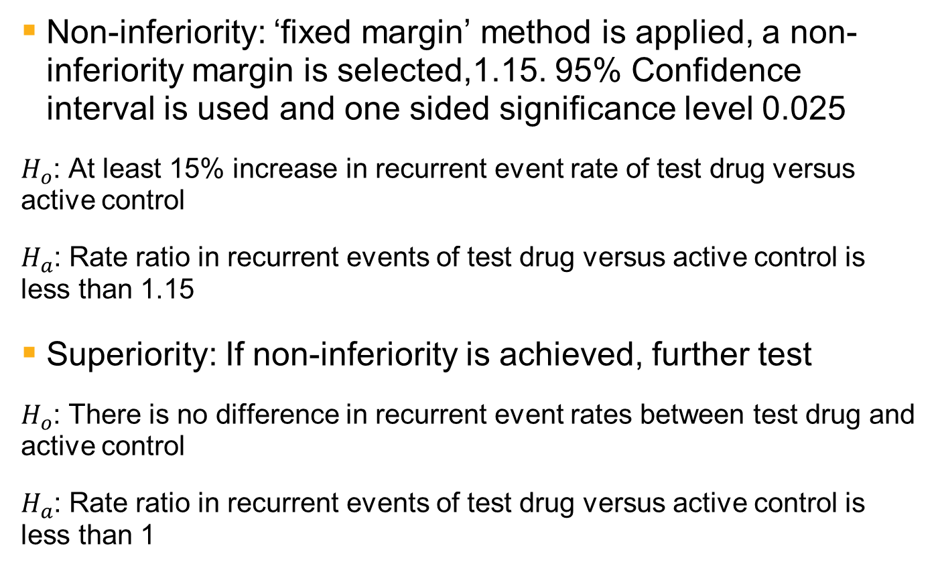
Hierarchical test procedures for both non-inferiority and superiority
Non-inferiority: ‘fixed margin’ method is applied, a non-inferiority margin is selected,1.15. 95% Confidence interval is used and one sided significance level 0.025
$H_{o}$: At least 15% increase in recurrent event rate of test drug versus active control
$H_{a}$: Rate ratio in recurrent events of test drug versus active control is less than 1.15
Superiority: If non-inferiority is achieved, further test
$H_{o}$: There is no difference in recurrent event rates between test drug and active control
$H_{a}$: Rate ratio in recurrent events of test drug versus active control is less than 1

Slide 9
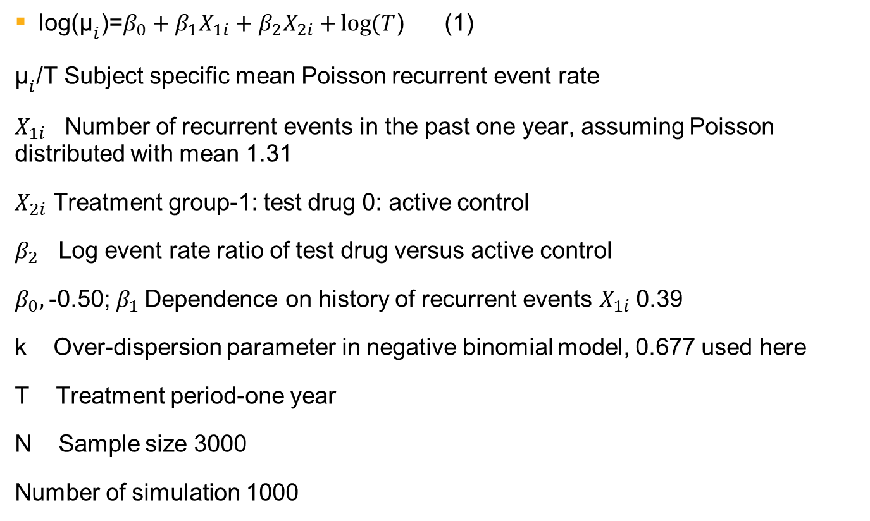
General simulation scenario
log⁡(${\text{μ}}_{i}$)=$β_{0}+β_{1}X_{1i}+β_{2}X_{2i}$ $+\log{(T}$) (1)
${\text{μ}}_{i}$/T Subject specific mean Poisson recurrent event rate
$X_{1i}$ Number of recurrent events in the past one year, assuming Poisson distributed with mean 1.31
$X_{2i}$ Treatment group-1: test drug 0: active control
$β_{2}$ Log event rate ratio of test drug versus active control
$β_{0},$-0.50; $β_{1}$Dependence on history of recurrent events $X_{1i}$0.39
k Over-dispersion parameter in negative binomial model, 0.677 used here
T Treatment period-one year
N Sample size 3000
Number of simulation 1000

Slide 10
Simulation scenarios for respective results-1
Result 1: Sample size and power of non-inferiority test under both Poisson regression and Negative binomial model; select event rate ratios-1, 1.05, 1.1 in sample size-2000, 3000, 5000 respectively; other parameters the same as those in general simulation scenario.
Results 2a: Simple violation of assumptions in Negative binomial model by mis-specifying Gamma distribution of Poisson event rate-log-normal, binary (Bernoulli) with same mean and variance; select event rate ratios 1.0, 1.05, 1.1,1.15,1.175,1.20; other parameters the same as those in general simulation scenario.
Results 2b: Violation of constant Poisson event rate in the assumptions of Poisson distribution by specifying Gamma distribution in negative binomial model, log-normal, binary (Bernoulli) with same mean and variance of Poisson event rate; select event rate ratios-1.0, 1.025, 1.05, 1.1,1.15,1.175,1.20,1.225; other parameters the same as those in general simulation scenario.

Slide 11
Simulation scenarios for respective results-2
Result 3a: Violation of single Poisson distribution in Poisson regression by mixture of two Poisson distributions. Percentages of Mixture Poisson distributions are 0.5+0.5, 0.7+0.3, 0.9+0.1 in three groups respectively. Event rate ratios are different in two mixture Poisson distributions-0.95x0.5+1.05x0.5, 0.95x0.7 +1.1667x0.3, 0.95x0.9 +1.45x0.1 in order to keep subject specific Poisson event rate the same in three groups after adjusting for history of recurrent events. Other simulation settings are similar to those in results 2b.
Result 3b: Violation of single Gamma distribution in negative binomial model by mixture of two Gamma distributions of subject specific Poisson event rate. Other simulation settings such as percentages of two Gamma distributions and event rate ratios are similar as above in results 3a.

Slide 12
Results-1 Sample size and power-Poisson regression and Negative binomial model
Power
Poisson regression
Negative Binomial Model
Notes:
With the increase in sample size, power of non-inferiority test increase as expected in both simple Poisson regression and Negative binomial model. The patterns between power and sample size of non-inferiority test are pretty similar in both simple Poisson regression and Negative Binomial model.

Slide 13
Results-2a Simple violation of Negative binomial model by specifying other than gamma distribution
Type I error rate
Power
Negative Binomial Model
Notes:
Besides mixed Poisson with random effect-Gamma distribution in Negative binomial model, mis-specifying by binary and log-normal distributions with same mean and variance. The results show no significant difference in type I error rates and relative small loss of power in non-inferiority test. Robustness remain relative well controlled.

Slide 14
Results-2b Simple violation of Poisson regression with different patterns of mixed Poisson data
Type I error
Power
Poisson regression with over-dispersion
Notes:
For mixed Poisson data with random effect-Gamma distribution in Negative binomial model, binary and log-normal distribution with same mean and variance, Poisson regression with over-dispersion show no significant differences in type I error rates of three misspecification groups comparing to simple Poisson group, and cause certain loss in power in three different random effect distributions. Robustness appears to remain controlled of non-inferiority test under assumption violation of constant Poisson event rate in Poisson distribution.

Slide 15
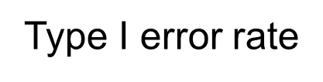
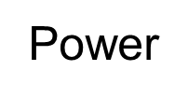
Result 3a Assumption violation-Mixture of Poisson distributions in Poisson regression
Non-inferiority test
Notes:
Mixture of Poisson distributions may reflect the heterogeneity of target patient population in treatment responses of test drug versus active control. Some subpopulation may have a better treatment effect of test drug than that in others. Generate two groups of mixture Poisson distributions with different mean recurrent event rate ratios of test drug versus active control to simulate this scenario reflecting the assumption violations in Poisson regression. Type I error and power of non-inferiority test are very close in various mixture patterns.

Slide 16

Subgroup analysis could show different result
log⁡(${\text{μ}}_{i}$)=$β_{0}+β_{1}X_{1i}+β_{2}X_{2i}$ $+β_{2}X_{3i}+β_{2}{X_{2i}∗X}_{3i}+log{(T}$) ${ X}_{3i}$: Subpopulation group, ${X_{2i}∗X}_{3i}$: the interaction between treatment and subpopulation group
 | Rate ratio | Hierarchical test procedure result
Total | 1.15 | Inferior | Non-inferiority type I error rate 0.033
Subgroup 1 50% | 1.2x1.15=1.38 | inferior | Non-inferiority type I error rate 0
Subgroup 2 50% | 0.8x1.15=0.92 | superiority | Superiority power 0.324
Notes:
Subgroup analysis includes the variable for the subpopulations showing different recurrent event rate ratio for test drug versus active control and the interaction term between treatment and this subpopulation variable for population heterogeneity for treatment responses. We show here an example with large difference of treatment responses in two subpopulations. Subgroup analysis suggest different conclusion based on hierarchical test procedure.

Slide 17
Result 3b Assumption violation-Mixture of Negative binomial distributions in Negative binomial model
Type I error
Power
Non-inferiority test
Notes:
Mixture of Gamma distributions may reflect the heterogeneity of target patient population of treatment responses of test drug versus active control. Some subpopulation may have a better treatment effect of test drug than that in others. Generate two groups of mixture Gamma distributions with different mean recurrent event rates of test drug adjusted for other covariates to simulate this scenario reflecting the assumption violations in negative binomial model. Empirical type I error and power of non-inferiority test are very close in various mixture patterns.

Slide 18
Subgroup analysis may show different result
Similar subgroup analysis in Negative binomial model as in Poisson regression, an extreme example is shown below
 | Rate ratio | Hierarchical test procedure result
Total | 1.0 | Non-inferior | Superiority type I error rate 0.024 Non-inferiority power 0.859
Subgroup 1 50% | 1.2x1.0 | inferior | Non-inferiority type I error rate 0.003
Subgroup 2 50% | 0.8x1.0 | superiority | Superiority power 0.892
Notes:
The similar subgroup analysis in negative binomial model for mixture patterns of gamma distributions. An extreme example will indicate the results of two subgroups from subgroup analysis could both different from that of main analysis without including subpopulation variable based on main analysis without including the covariate for subpopulations.

Slide 19
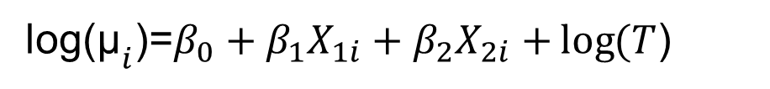
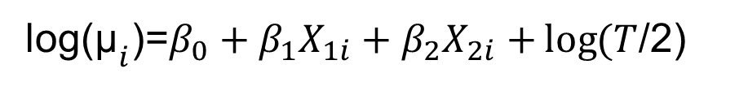
Result 4a Non-constant subject specific event rate over the whole treatment period
Recurrent events during past time T
Recurrent events in the whole treatment period T
Recurrent events during past time T/2
Recurrent events in the first ½ treatment period
Recurrent events in the second ½ treatment period
log⁡(${\text{μ}}_{i}$)=$β_{0}+β_{1}X_{1i}+β_{2}X_{2i}$ $+\log{(T}$)
log⁡(${\text{μ}}_{i}$)=$β_{0}+β_{1}X_{1i}+β_{2}X_{2i}$ $+\log{(T}$/2)
Assume treatment effect of test drug is not homogenous over the whole treatment period. Set different event rate ratios of test drug versus active control for first and second ½ treatment periods and compare the empirical type I error and power under both moderate and weak dependence on previous recurrent events in half an year period respectively.
Notes:
Poisson regression and Negative binomial model both assume the constant mean recurrent event rate over the whole treatment period for each subject. Try to explore the robustness of non-inferiority test by assuming different treatment effects of test drug during first and second half treatment periods for individual patients. We generate the data in two one half treatment periods with moderate and weak dependence on recurrent events in past half an year separately. Run Poisson regression or negative binomial model using the first model.
Compare empirical type I error and power in both superiority and non-inferiority test procedures in Poisson regression and Negative binomial model under moderate and weak dependence respectively.

Slide 20
Empirical type I error of non-inferiority test-Poisson regression
Moderate Dependence
Weak Dependence
Type I error
Notes:
Simulate the recurrent event data with Poisson distribution in first and second ½ treatment period separately and in three groups same total mean event rate except that mean recurrent event rates over first half and second half treatment period are different in test drug group under moderate and weak dependence on recurrent events in past half an year respectively. Large inflation in empirical type I error of non-inferiority test with moderate dependence on recurrent events history in treatment effect and treatment effect is stronger in first ½ treatment period. The degree of inflation is smaller in weak dependence and treatment effect is stronger in first ½ treatment period group. Empirical type I errors in the group where treatment effect is stronger in second ½ treatment period under both moderate and weak dependence are smaller than those where treatment effect is homogeneous over the whole treatment period respectively.

Slide 21
Empirical power of non-inferiority test-Poisson regression
Moderate Dependence
Weak Dependence
Power
Notes:
Similar data is generated as above in three different groups with different total mean recurrent event rate over the whole treatment period. Empirical power of non-inferiority test increase in the groups with strong effect in first ½ treatment period under both moderate and weak dependence. The degree of power gain in larger in moderate dependence. Certain loss of power in the groups with strong effect in second ½ treatment period under both moderate and weak dependence. There is less loss of power in weak dependence.

Slide 22
Empirical type I error of non-inferiority test-Negative Binomial model
Type I error
Notes:
Simulate individual mean recurrent event rate from gamma distribution with total mean the same for three groups except the means are different in first and second ½ treatment periods with test drug group separately. Large inflation in empirical type I error of non-inferiority test with moderate dependence on recurrent events history in treatment effect and treatment effect is stronger in first ½ treatment period. The degree of inflation is smaller in weak dependence and treatment effect is stronger in first ½ treatment period group. Empirical type I errors in the group where treatment effect is stronger in second ½ treatment period under both moderate and weak dependence are smaller than those where treatment effect is homogeneous over the whole treatment period respectively

Slide 23
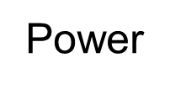
Empirical power of non-inferiority test-Negative Binomial model

Slide 24
Summary
Robustness of Negative binomial model remains well control for simple violation of negative binomial model assumption by misspecification of gamma distribution.
The validity and efficiency of hierarchical test procedure seem to keep the same for different degrees of population heterogeneity of treatment effect. Poisson regression and Negative binomial model fail to detect this type of population heterogeneity if respective covariate and its interaction with treatment variable are not included in the model (subgroup analysis).
If treatment effect of test drug is not constant over the whole treatment period and dependence exists between previous recurrent events and current ones, then it may cause either inflation in type I error or efficiency loss for hierarchical test procedures under certain circumstances. The degree of both inflation in type I error and efficiency loss may correlate with the dependence on history of recurrent events.

Slide 25
References
Oliver N.K., Mark RK Jones, Peter W.L. and Julie A. (2007) Analysis of exacerbation rates in asthma and chronic obstructive pulmonary disease: example from the TRISTAN study. Pharmaceutical Statistics; 6: 89–97
Richard J.C., Ker-Ai Lee and Hongdan Li (2007) Non-inferiority trial design for recurrent events. Statistics in Medicine; 26: 4563-4577
Tsong Y, Wang SJ, Hung HMJ, Cui L. Statistical issues on objective, design and analysis of noninferiority active-controlled clinical trial. Journal of Biopharmaceutical Statistics 2003; 13:29–41.
Wang SJ, Hung HMG, Tsong Y. Utility and pitfalls of some statistical methods in active controlled clinical trials. Controlled Clinical Trials 2002; 22:15–28.
Guidance for Industry Non-Inferiority Clinical Trials. Silver Spring (MD): US Food and Drug Administration. 2010.

